Slide 1
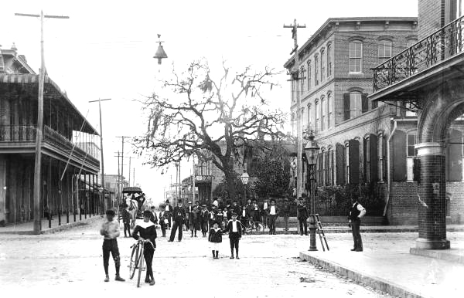
Destemming the Cigar City
The sociological lens of
Celia y Yunior
Notes:
Photo: At the intersection of 14th street and 9th avenue, Ybor City, Tampa, Florida. Havana-American Cigar Factory

Slide 2
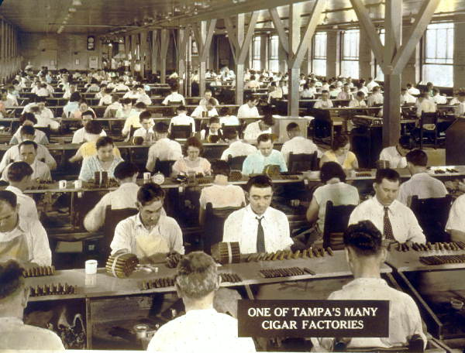
Notes:
Photo Credit:
Tampa’s tobacco industry: 192-
State Archives of Florida, Florida Memory

Slide 3
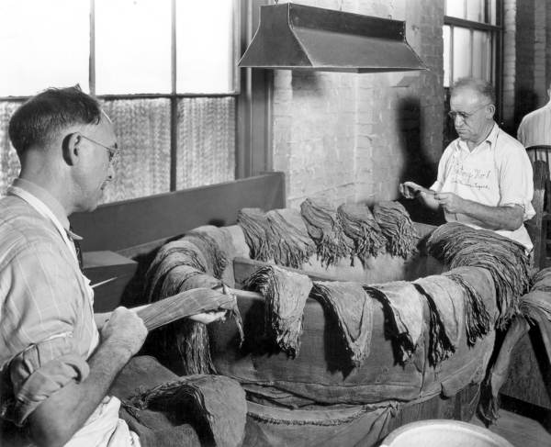

Slide 4
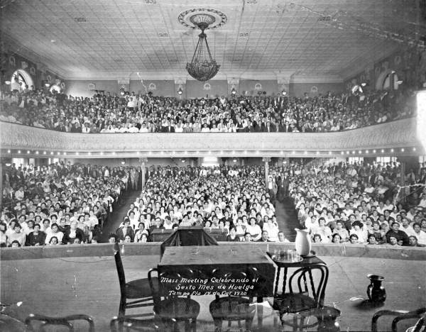
Notes:
Photo credit:
Mass meeting of cigar workers on strike – Tampa, Florida. 1920
State Archives of Florida, Florida Memory

Slide 5
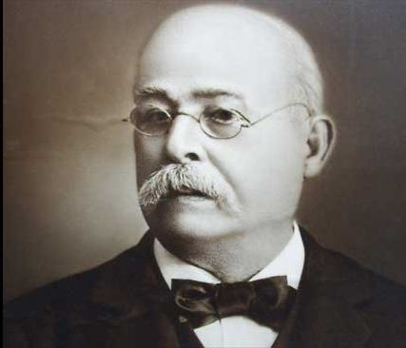
The Rise of Cigar City
Vicente Martínez Ybor established a cigar factory in Key West in 1869
In 1885, moved cigar making to Tampa
The area around the cigar factories became known as Ybor City.
Immigrants came from Cuba, Latin America, and Europe in search of work
By 1910, there were over 150 factories in Tampa employing 10,000 workers.
Notes:
Vicente Martinez Ybor initially fled Cuba to escape persecution after being associated with revolutionaries.

Slide 6
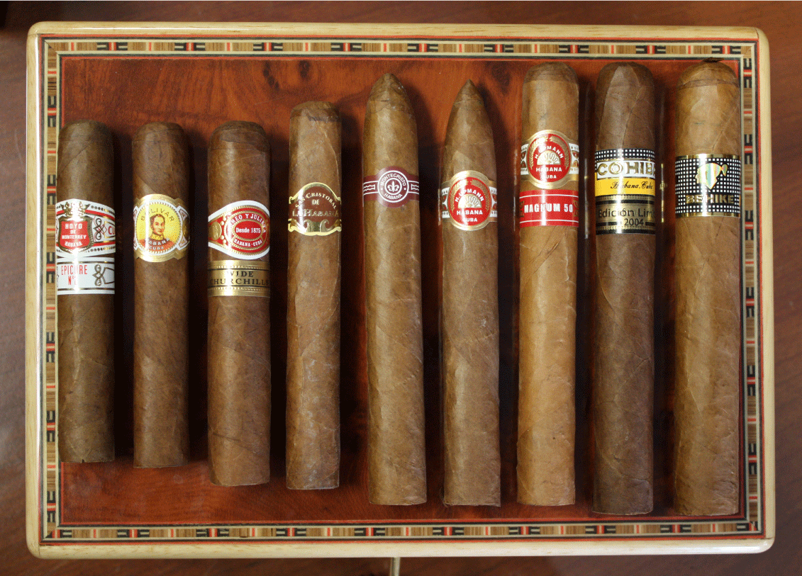
Cigar City in Decline
1929: the Great Depression hit the cigar industry as American preferred cheaper machine-made cigars
1960-61: U.S. imposed Cuban trade embargo; causing many factories to relocate to Honduras, Nicaragua, and the Dominican Republic

Slide 7
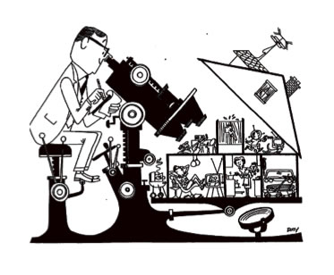
Sociological Levels of Analysis
Macro-level: large scale processes such as social stability and change
Micro-level: small scale interactions between individuals, such as conversation or group dynamics

Slide 8
Celia y Yunior
The two have been working together since 2004
Their installation projects focus on the organization of society and daily life
They created a special installation for the exhibit at USF CAM
Celia González Alvarez &
Yunior Aguiar Perdomo

Slide 9
Varaentierra (2018)

Slide 10
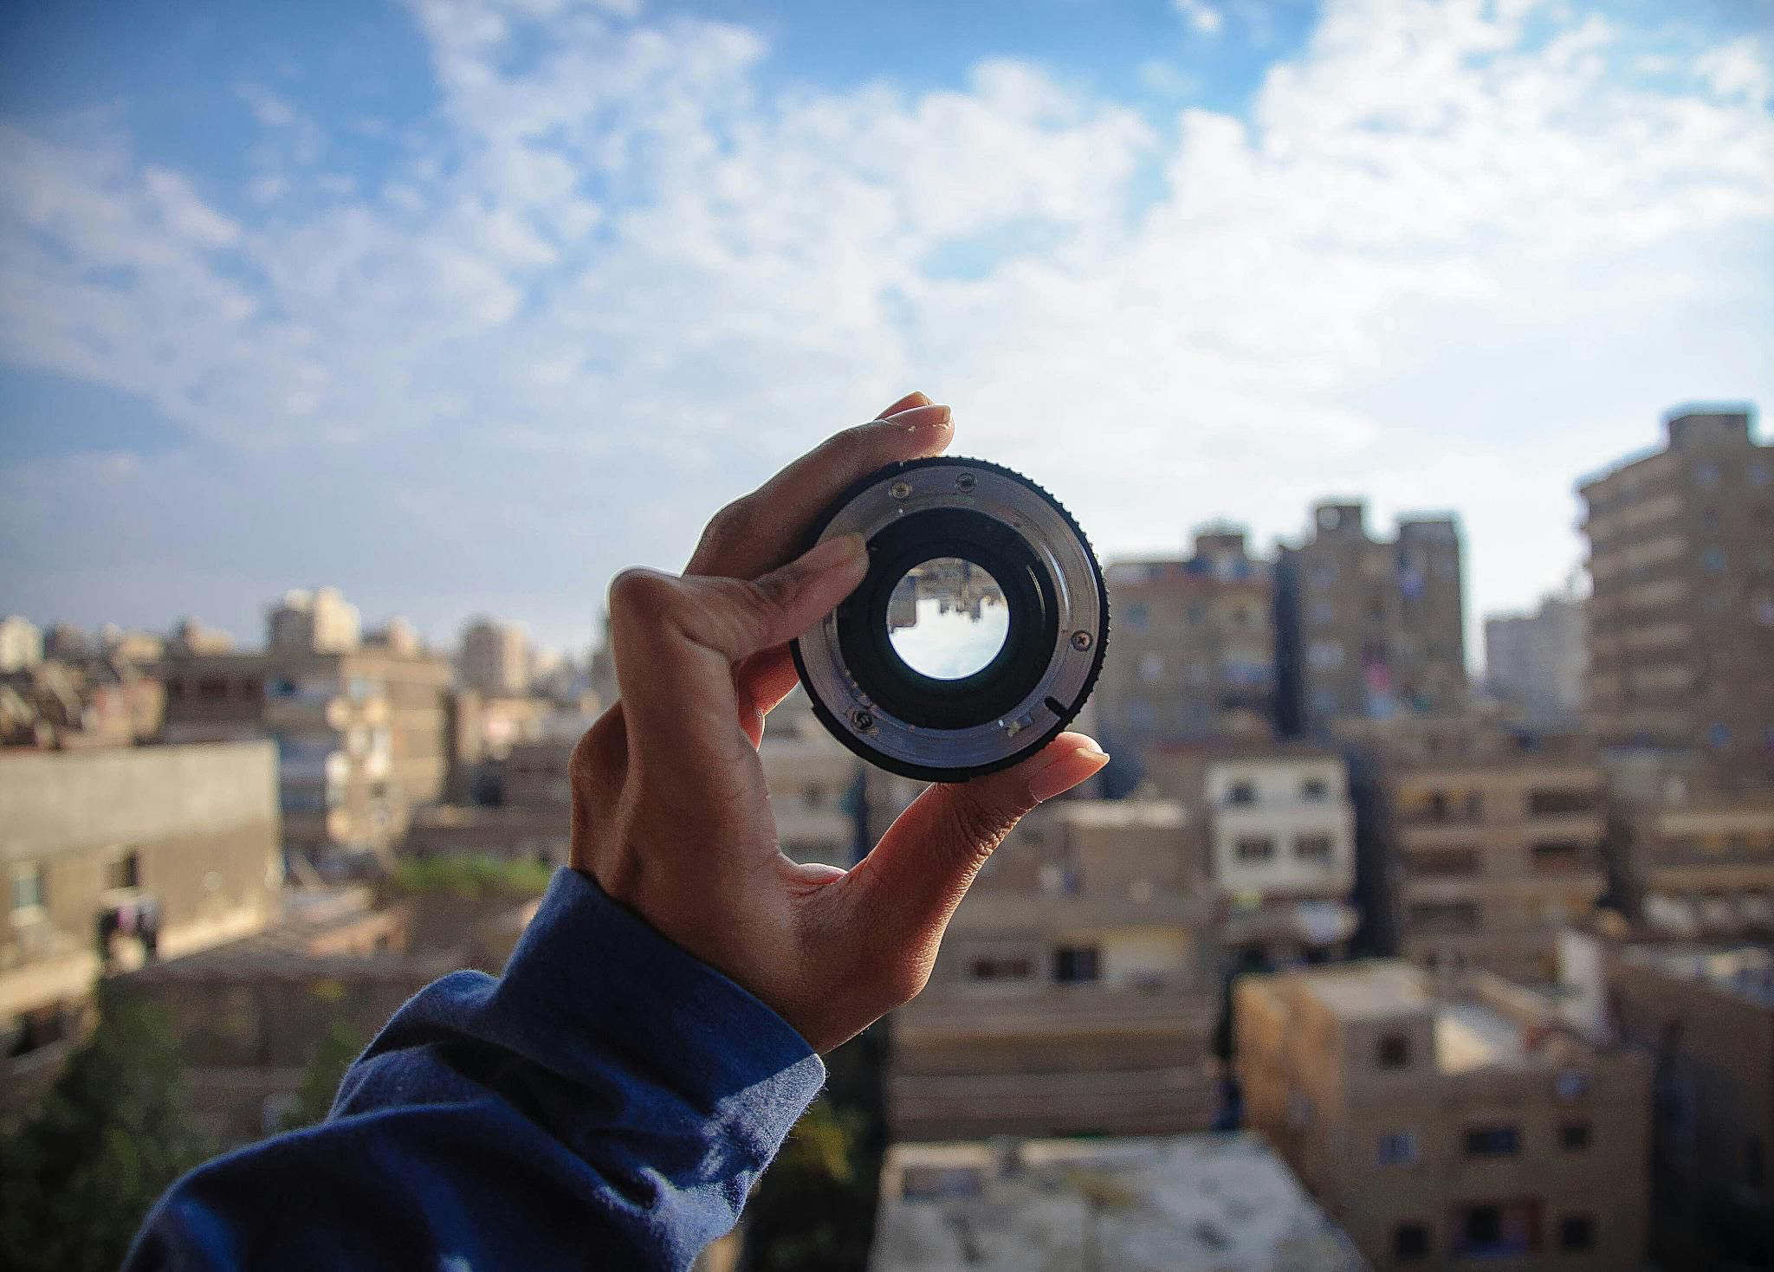
Reflection
In what ways do Celia y Yunior turn a sociological lens on the relationship between Tampa and Havana?

