Slide 1
Wanda Raimundi-Ortiz
“Promoting Radical Empathy”
Notes:
Image source: https://www.ucf.edu/news/exodus-pilgrimage-performance-honors-puerto-rican-traditions-ucf-celebrates

Slide 2
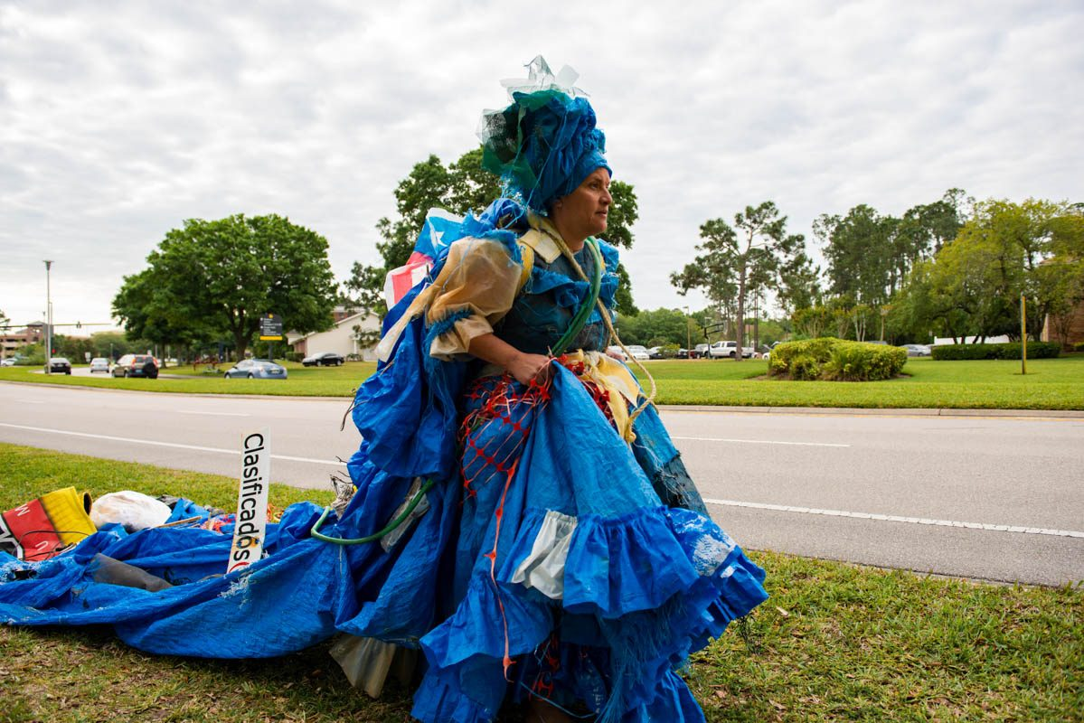
Notes:
Closely view the image, making note of the person, what she is wearing, what it is made of, and think about where she might be going.
Hurricane Maria Dress (provisional title), 2019
Mixed media (Recovered FEMA tarps and debris from Puerto Rico, December, 2018)
6' length (approx), 45lbs (approx)
Designed by Kristina Tollefson in collaboration with Wanda Raimundi-Ortiz
Source: https://www.raimundiart.com/exodus-pilgrimage

Slide 3
Hurricane Maria, Sept 2017
Category 5 storm
In Puerto Rico, the winds spanned the entire island
Massive flooding
All residents lost electricity
Telephone communication was disrupted
$92+ billion in damages
80% agriculture crops lost
85% homes were damaged
50,000+ residents displaced
2,975 lives lost in PR
Hurricane Maria approaching Puerto Rico, Sept 19, 2017
Notes:
Hurricane Maria devastated Puerto Rico, making landfall on September 20, 2017.
The storm had already caused widespread destruction in Dominica as a Category 5 storm, and it alternated between Category 4 and 5 as it approached Puerto Rico. With a minimum pressure of 908 hPa, Maria was the tenth most intense Atlantic hurricane on record.
Source: climate.gov, NOAA, https://www.climate.gov/news-features/understanding-climate/hurricane-marias-devastation-puerto-rico

Slide 4
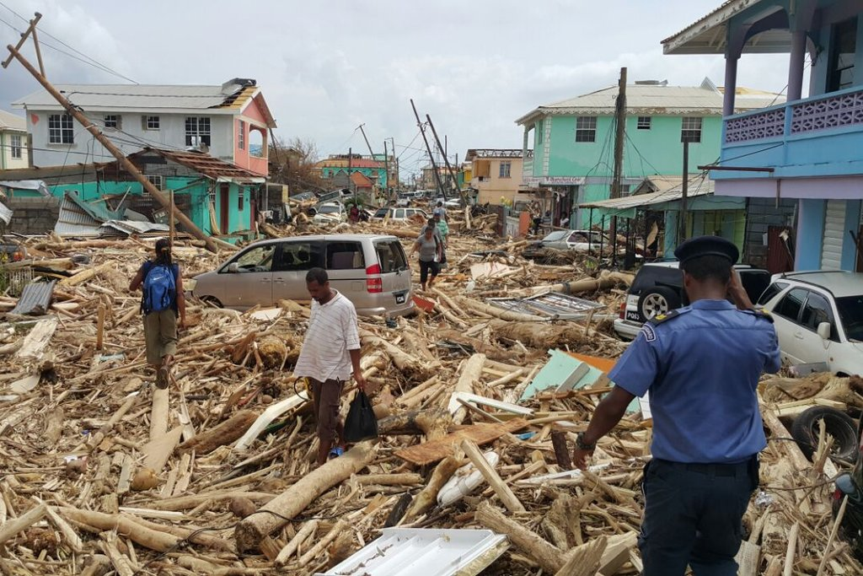
Notes:
Source: New York Times, https://www.nytimes.com/2017/09/21/us/hurricane-maria-puerto-rico.html

Slide 5
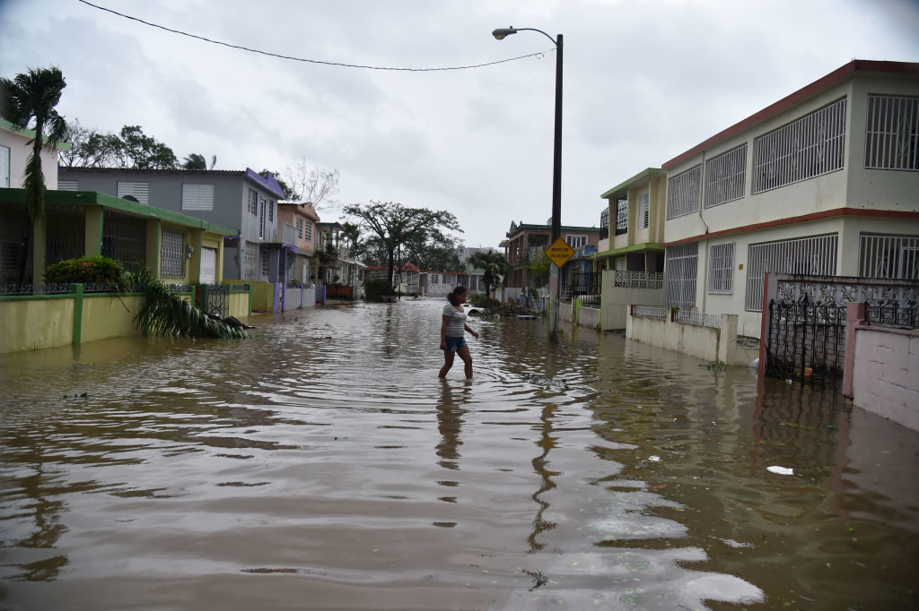
Notes:
Source: ArtNet News, https://news.artnet.com/art-world/puerto-rico-museums-hurricane-maria-1094639

Slide 6
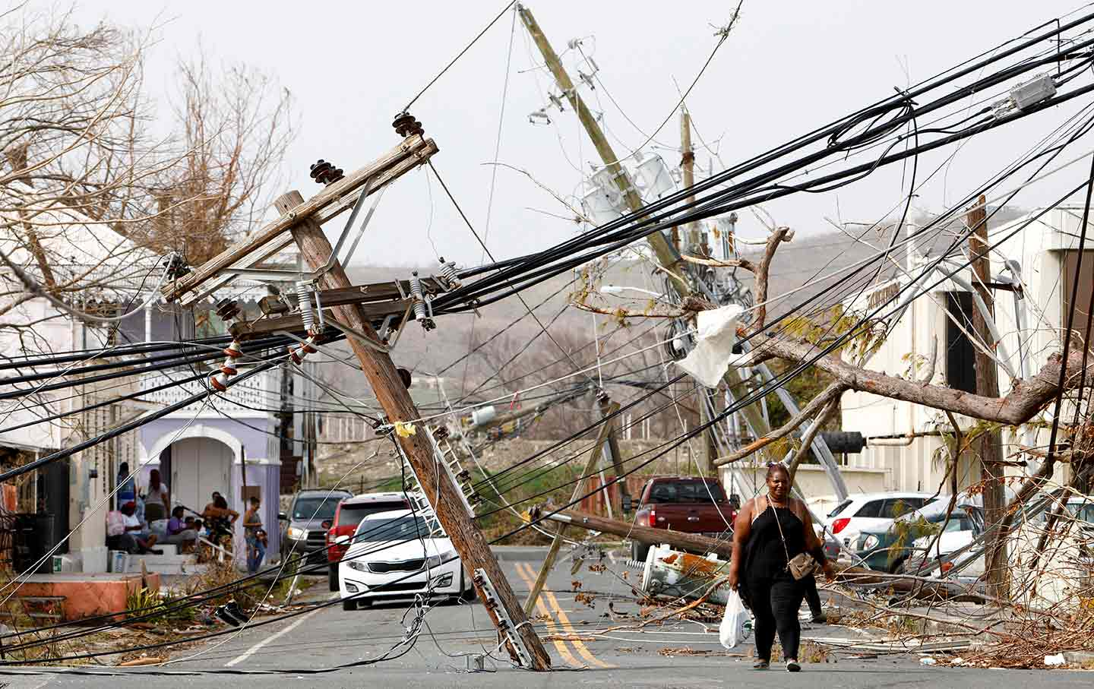
Notes:
Source: The Nation, https://www.thenation.com/article/archive/the-2017-hurricanes-didnt-just-hit-puerto-rico-they-hit-the-caribbean/

Slide 7
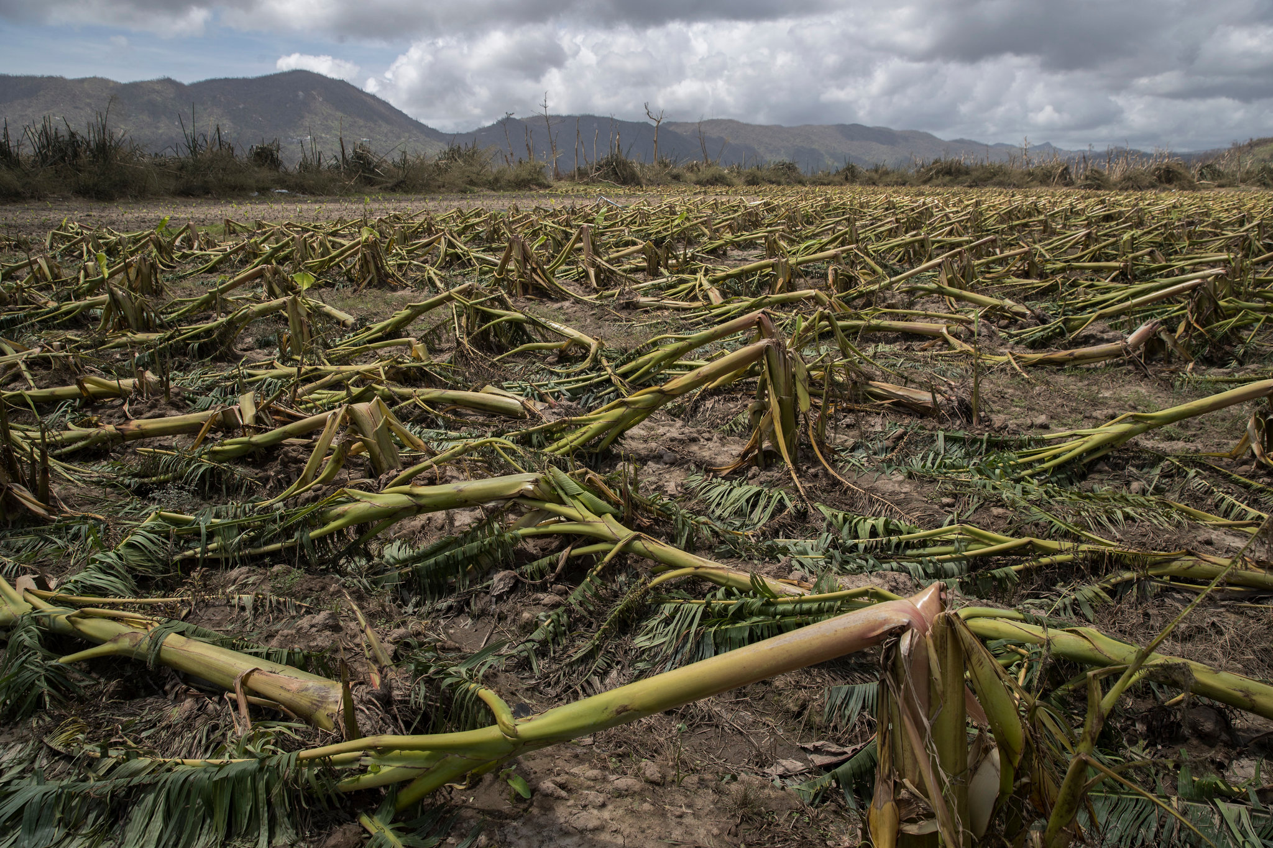
Notes:
Source: New York Times, https://www.nytimes.com/2017/09/24/us/puerto-rico-hurricane-maria-agriculture-.html

Slide 8
EXODUS | PILGRIMAGE (2019)
Notes:
From https://www.raimundiart.com/exodus-pilgrimage:
EXODUS | PILGRIMAGE is a public performance addressing forced migration of thousands of Puerto Ricans to the United States with whatever they could salvage on their backs to Florida cities (such as Miami and Orlando) and the trauma to those left behind as a result of Hurricane Maria.
Hurricane Maria Dress, 2019
Mixed media (Recovered FEMA tarps and debris from Puerto Rico, December, 2018)
6' length (approx), 45lbs (approx)
Designed by Kristina Tollefson (teaches costume and makeup design in UCF’s Dept of Theatre) in collaboration with Wanda Raimundi-Ortiz
This project not only focuses on the catastrophic results of the hurricane but also serves as an homage devoted to the strength, beauty and resilience of the Puerto Rican community both on the island and stateside.
Dressed in attire made from hurricane debris that references Afro-Puerto Rican folkloric wardrobe, Wanda dragged a debris “train” behind her as part of a ritualistic “pilgrimage” along the downtown Orlando cultural corridor.

Slide 9
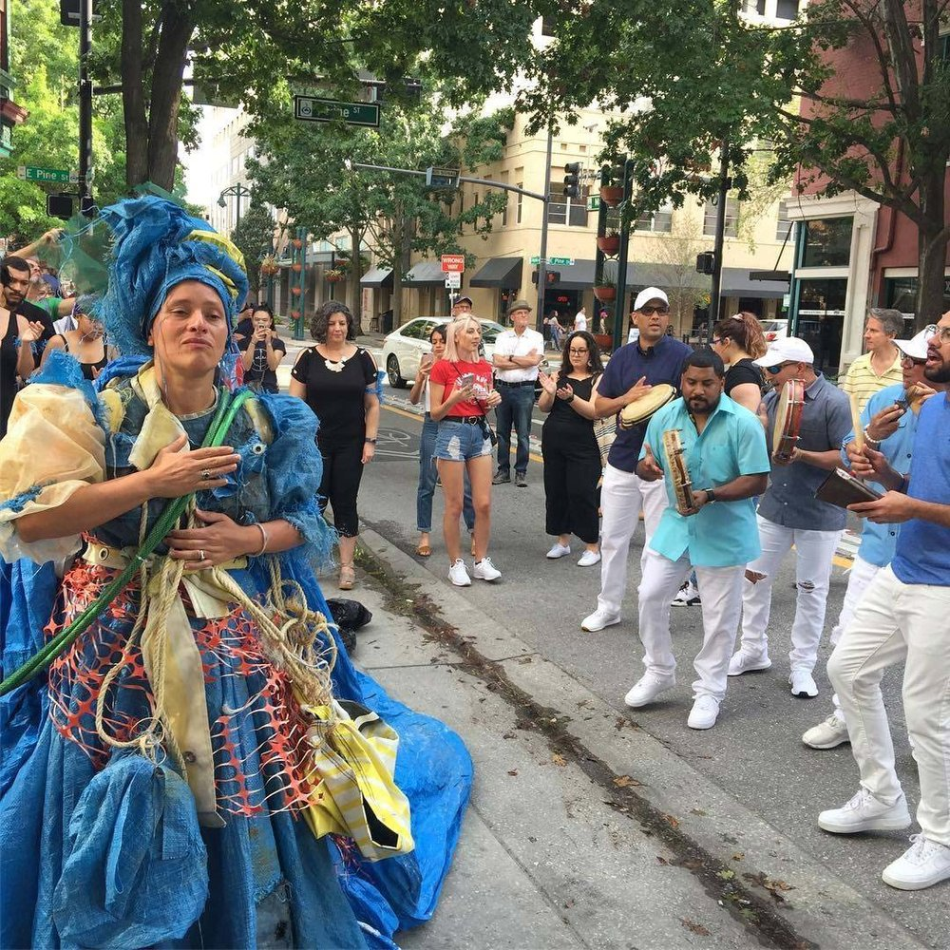
Notes:
From https://www.raimundiart.com/exodus-pilgrimage:
The artist was accompanied by live Afro Puerto Rican folkloric Plena singers throughout her journey. These processions are direct references to traditional impromptu outdoor street events, called parrandas, which are used to call community members out of their homes and join the singing, which customarily ends in a large celebration of music and food.
Plena music derived from working-class Puerto Ricans who use handheld instruments and singing to communicate about current events through a periodico cantado, or “sung newspaper.”
“It’s very much community activated. You have the person singing chants and another person comes back [with a chant] and the next person will call for next verse and the community will sing it back,” Raimundi-Ortiz says.
“Not to disparage reggaetón, but that’s not the only representation of our people. Before there was reggaetón, there was bomba, plena. The roots, the base, the foundation of the Daddy Yankees, the Bad Bunnys [of the world], this is the core of it,” Raimundi-Ortiz says. “This is how we communicate. This is how we shared our stories. This is how we kept attached to our African roots. This is how we connected.”
Source: https://www.ucf.edu/news/exodus-pilgrimage-performance-honors-puerto-rican-traditions-ucf-celebrates/

Slide 10
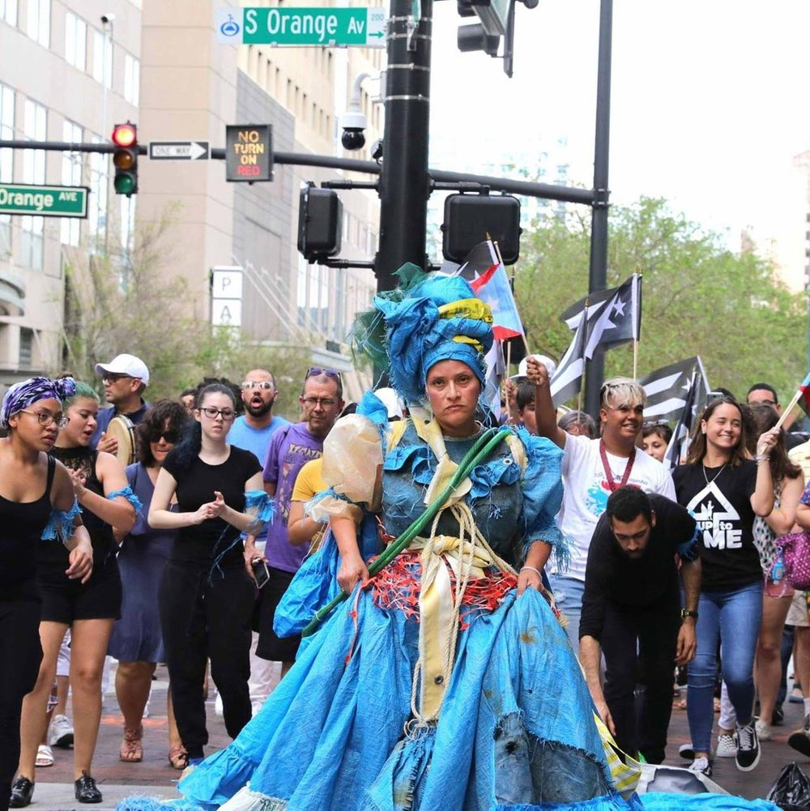
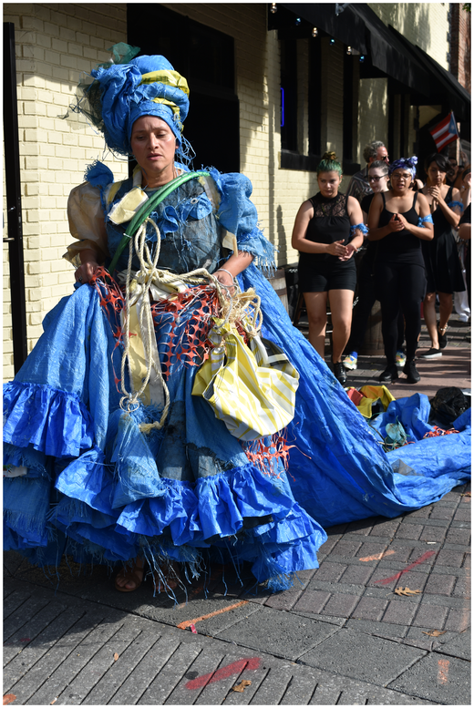
Notes:
From https://www.raimundiart.com/exodus-pilgrimage:

Slide 11
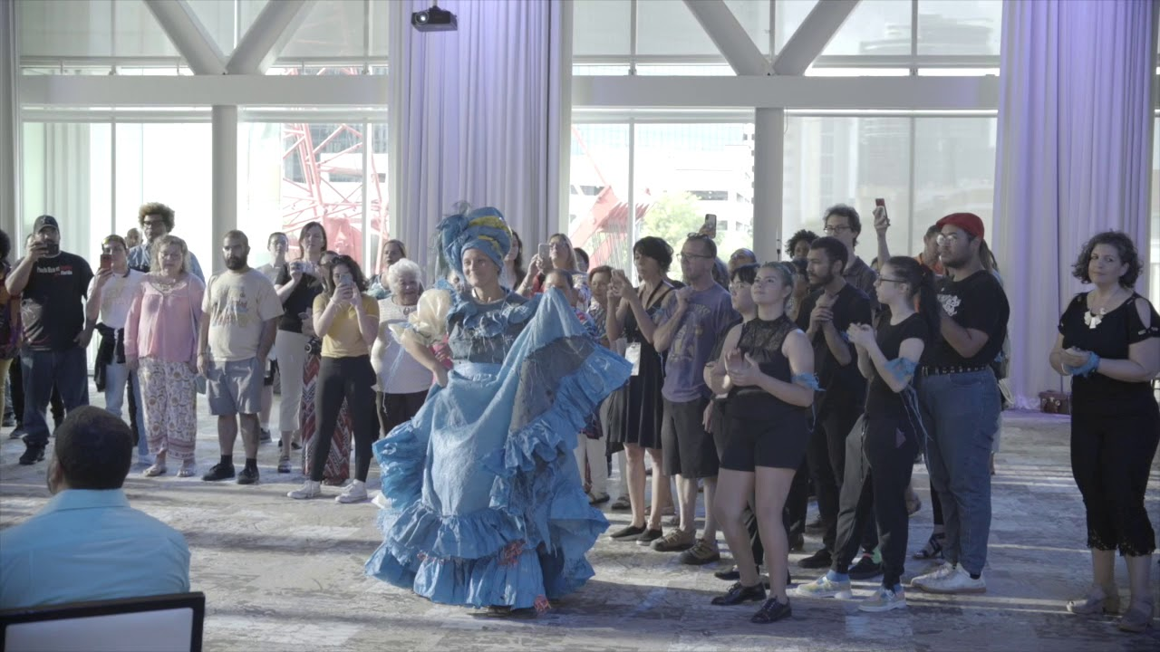
Notes:
This variation culminated in a bombazo, Afro-Puerto Rican drumming and dancing, performed inside the Dr. Phillips Performing Art Center DeVos Ballroom in Orlando, Florida. Musicians, dancers, artists, and scholars greeted those that followed Raimundi-Ortiz in the street in the event.
Raimundi-Ortiz danced along to an all-female bomba drumming circle, a departure from tradition that dictates only men are allowed to touch the instruments. She wanted to utilize bomba, which is a call-and-response music and dance style, because it relates to the theme of forced migration and is rooted in Afro-Puerto Rican culture since African slaves created the music style as a form of communication.

Slide 12
Exodus/Pilgrimage (Éxodo/Peregrinaje)
Notes:
Show the 5:12 min video that chronicles both the artist’s trip to Puerto Rico in December 2018 and the performance piece, Exodus/Pilgrimage (Éxodo/Peregrinaje).
It can be accessed at either:
https://www.raimundiart.com/exodus-pilgrimage OR
https://www.youtube.com/watch?v=25cuxybVwVQ&t=35s

Slide 13
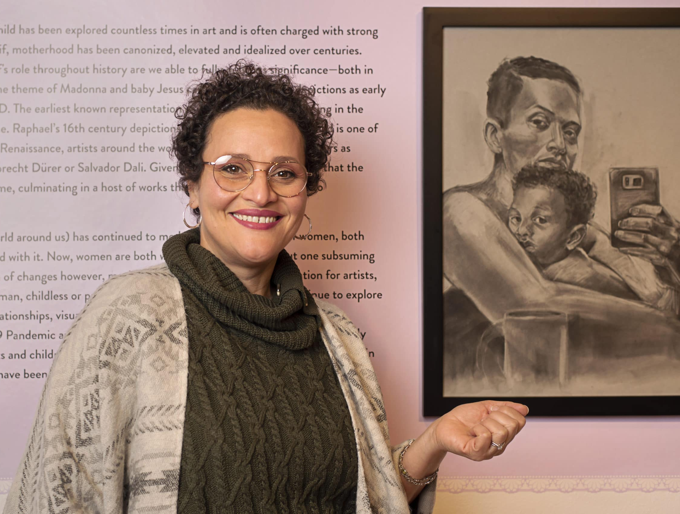
“As much as this performance is about forced migration under duress, it’s [also] about resilience. My intention is not to have a broken back — [but] to stand tall.” Wanda Raimundi-Ortiz

Slide 14
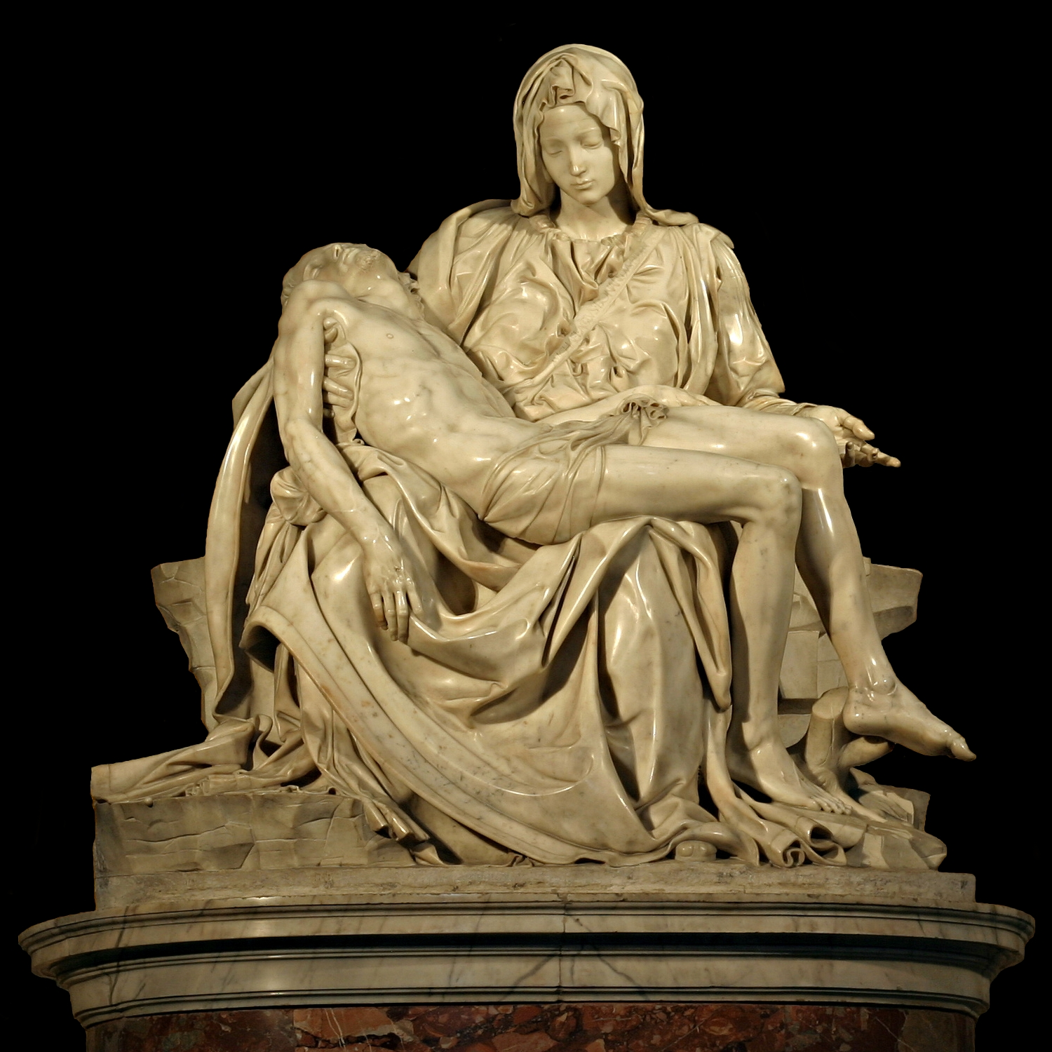
Pietà (Michelangelo, 1498-1499)
Notes:
Ask:
Have you ever seen this work?
Who is it by?
What is the content of the work?
What emotions does the work convey?
Debrief:
A pietà in Christianity is art (most typically a sculpture) depicting the Virgin Mary cradling the dead body of her son, Jesus, after his crucifixion. The most famous of these is Michelangelo Buonarroti’s work, sculpted 1498-1499 and now residing in St. Peter’s Basilica in Vatican City.

Slide 15
An interview with the artist
Notes:
Have students watch a brief (2:48min) interview with Wanda Raimundi-Ortiz regarding her work, Pietà (2017): https://www.raimundiart.com/pieta or https://www.youtube.com/watch?v=V7eWKWQWh-A.
Viewing guide: Ask them to consider the influences and concerns that served as foundations for her performance piece.

Slide 16
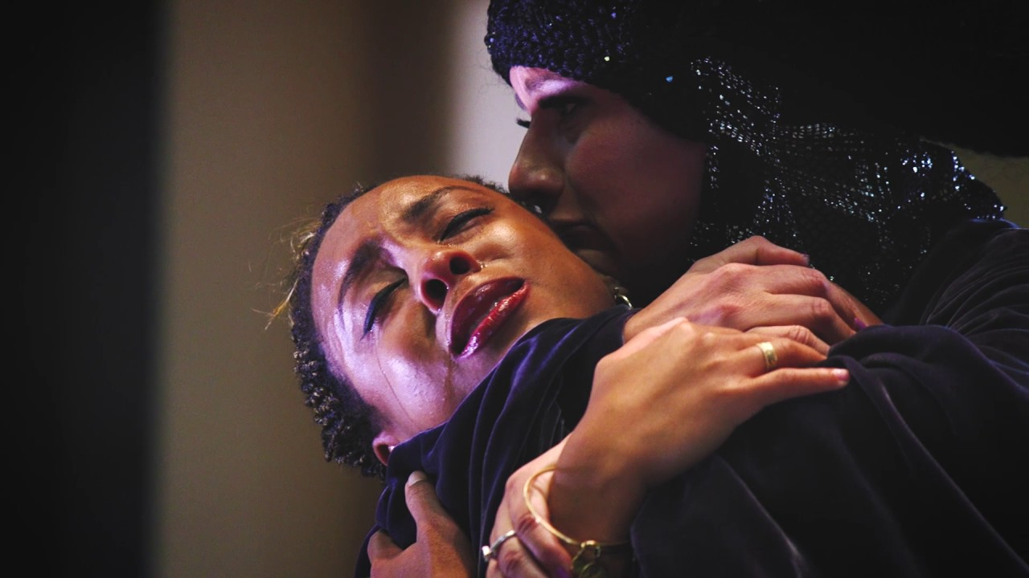
Pietà (Raimundi-Ortiz, 2017)
Notes:
Raimundi-Ortiz’s Pieta performance in 2017, during which she acted as Michelangelo’s Mary and held 33 members of marginalized communities.
Michelangelo's Pietà served as a source of inspiration for Raimundi-Ortiz's performance. The artist re-enact Mary's gesture of mourning, cradling 33 individuals (people of color and members of the LGBTQ community, specifically) in her arms for three minutes and 33 seconds each, a reference to the age Jesus was when he died.
Raimundi-Ortiz worked with designer and fellow UCF professor Kristina Tollefson to create her costume, inspired by the carven robes draped around Michelangelo's Mary, in a "communion of mothers discussing and consoling.“
Source: https://www.raimundiart.com/pieta

Slide 17
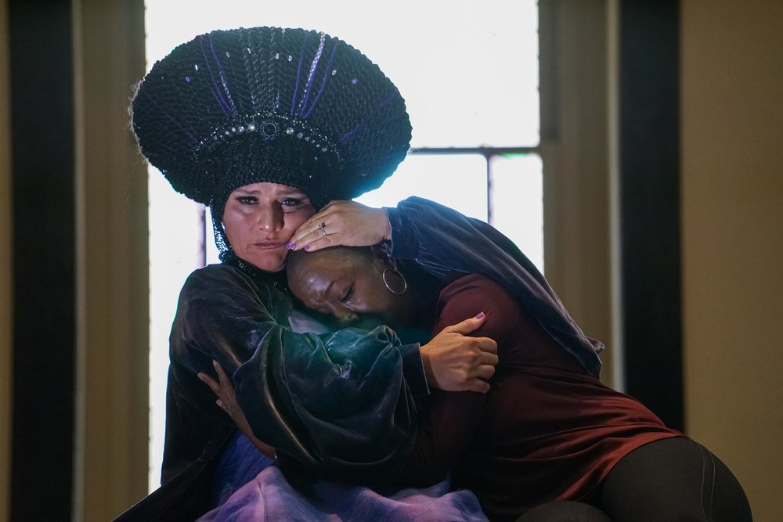
Pietà (Raimundi-Ortiz, 2017)
Notes:
Raimundi-Ortiz’s Pieta performance in 2017, during which she acted as Michelangelo’s Mary and held 33 members of marginalized communities.
Michelangelo's Pietà served as a source of inspiration for Raimundi-Ortiz's performance. The artist re-enact Mary's gesture of mourning, cradling 33 individuals (people of color and members of the LGBTQ community, specifically) in her arms for three minutes and 33 seconds each, a reference to the age Jesus was when he died.
Raimundi-Ortiz worked with designer and fellow UCF professor Kristina Tollefson to create her costume, inspired by the carven robes draped around Michelangelo's Mary, in a "communion of mothers discussing and consoling.“
Source: https://www.raimundiart.com/pieta

Slide 18
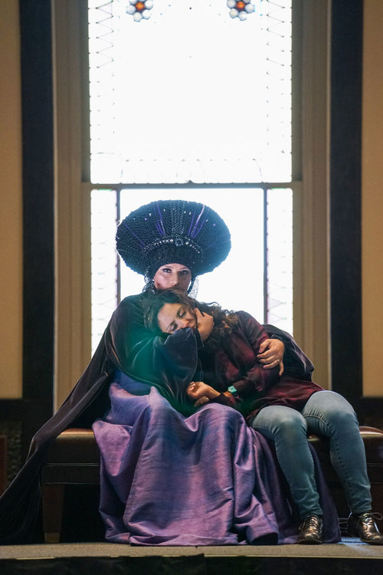
Pietà (Raimundi-Ortiz, 2017)
Notes:
For Pietà, the artist channels the Virgin Mary as an archetypal grieving mother, in response to our current cultural milieu. "I am afraid of what has been happening to brown folks," says Raimundi-Ortiz, "both young and old people of color who are brutalized, and their family members [who] are treated like they deserve what they got. There is a sense of collective mourning and fear that every person of color feels for their child. Every parent is terrified for their child.“
Source: https://www.raimundiart.com/pieta

Slide 19
Creating a space for “radical empathy”
How do both Raimundi-Ortiz’s works, Exodus/Pilgrimage and Pietà, create a space for “radical empathy”?

